Slide 1
Prokash: Introducing an Efficient Approach for Bengali Fake News Detection
Final Defense
CSE 4098C – Capstone Project
Md Abrar Saief Safat (203014020)
Sabreena Islam Khan (203014001)
Humayera Hedayet (203014024)
Jason D Costa (211014011)
Suravi Akhter
Senior Lecturer
CSE Department, ULAB
25 May, 2025

Slide 2
Table of Content
Problem Statement
Objectives
Motivation
Findings from Literature Review
Methodology
Design and Implementation
Result and Discussion
Timeline
Demonstration
Reference

Slide 3
Problem Statement
The rise of social media has made fake news a significant issue, but while much research focuses on detecting fake news in English and other major languages, Bengali fake news detection is underexplored. Current models often fail to capture Bengali linguistic nuances, leading to poor accuracy. A proposed hybrid model combining DistilBERT with Bidirectional LSTM, optimized through Grid Search, aims to improve detection by leveraging both contextual and sequential text features, enhancing accuracy and reducing misclassification.

Slide 4
Objectives
Dataset Preparation and Pre-processing: Clean the data set, irrelevant characters and noise by using Bangla specific tool (BNLP).
Model Development: Include DistilBERT for contextual embedding as well as BiLSTM for sequence modeling. Use Grid Search in order to find the best hyperparameter (learning rate, batch size, activation functions, etc).
Model Training: Train the hybrid model with an even dataset through some validation techniques. Evaluate the model using Accuracy, Precision, Recall, F1-score, and ROC-AUC.
Final Model Validation and Analysis: Performing error analysis to identify common misclassifications and analyze confusion matrix results.

Slide 5
Motivation
Our motivation lies in bridging the research gap by developing a hybrid deep learning model that combines DistilBERT and BiLSTM—an approach proven effective for capturing both contextual meaning and sequential dependencies. The integration of Grid Search further ensures optimal performance through fine-tuning.
DistilBERT’s multilingual capacity and lighter architecture make it especially suitable for low-resource languages like Bengali, offering reduced computational cost without sacrificing signficant performance.
Through complex engineering tailored for Bengali, we aim to provide a practical tool for researchers and developers focused on misinformation mitigation.
This project contributes not only to technical innovation but also to societal well-being by promoting trustworthy information dissemination in the digital platforms.

Slide 6
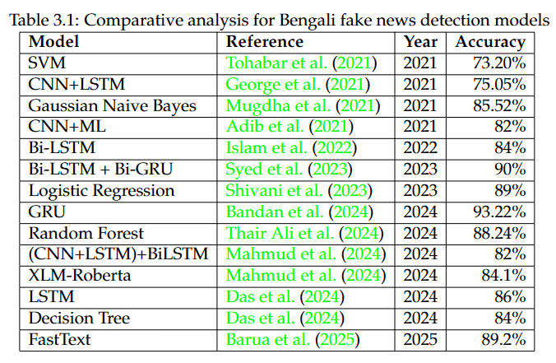
Findings from Literature Review

Slide 7
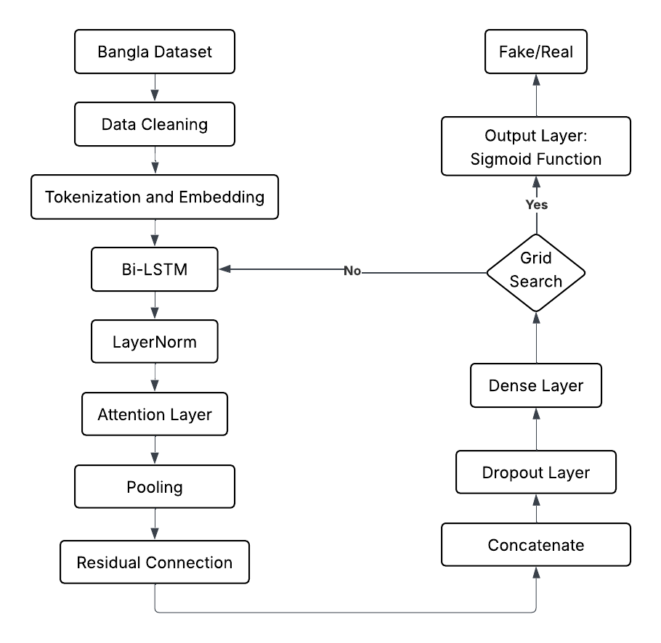
Methodology

Slide 8
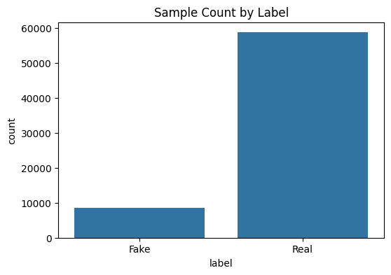
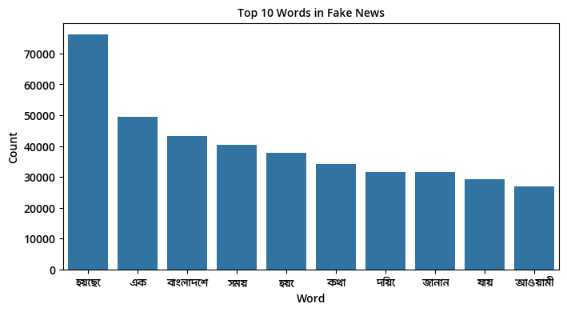
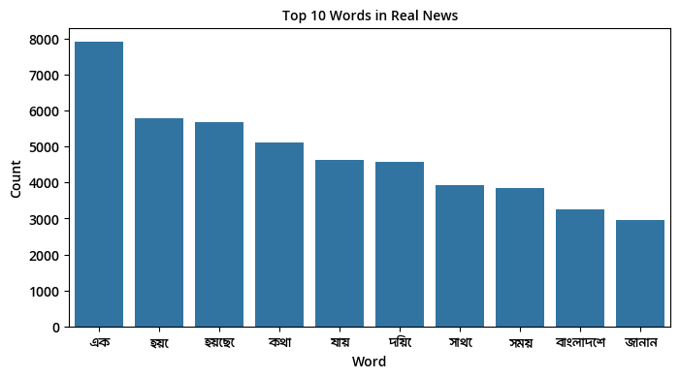
Data Analysis

Slide 9
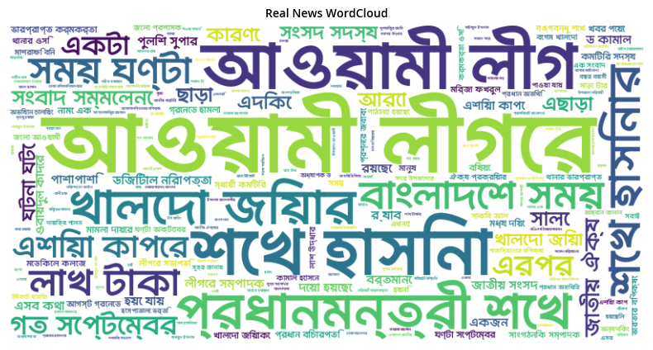
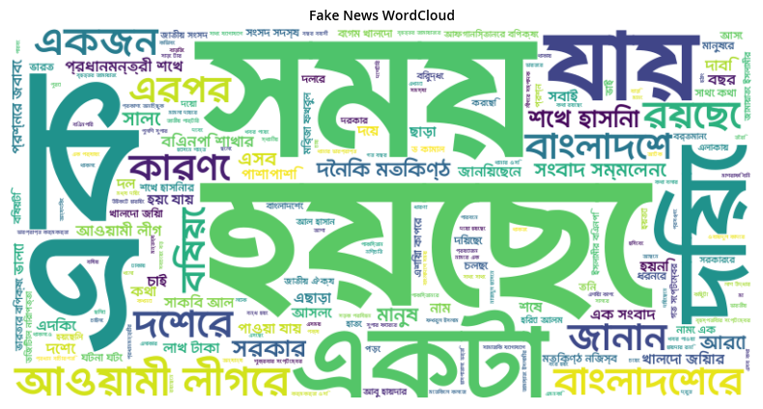
Word Cloud

Slide 10
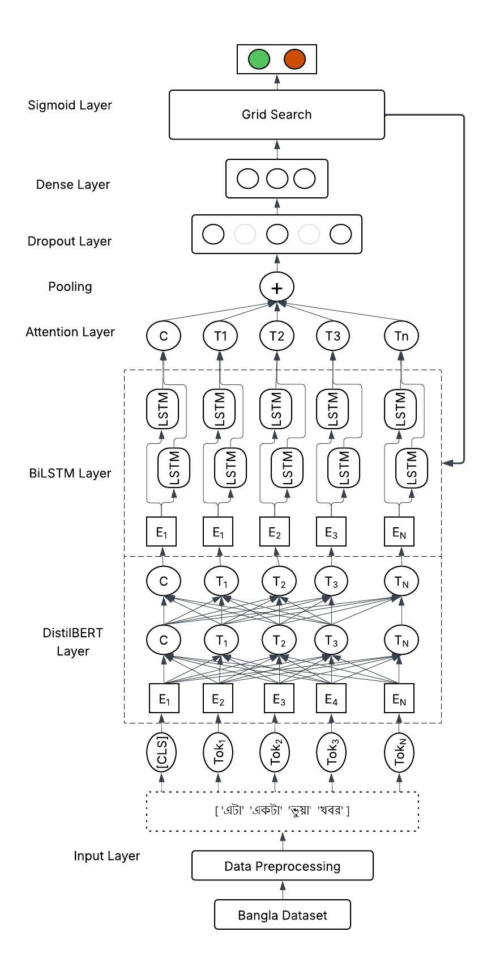
Model Design
Data Sources: Multiple Bengali news datasets (fake & real), merged and preprocessed.
Extensive text cleaning: removed stopwords, punctuation, symbols, and digits text.
Feature Engineering: Combined headline, and content fields.
Model Architecture: DistilBERT for feature extraction and performing multilingual contextual embedding.
BiLSTM for sequence modeling.
Attention Layer to focus on important tokens.
Pooling & Residual Connections for richer feature representation.
Evaluation Metrics: Accuracy, F1, Precision, Recall, Confusion Matrix, Receiver Operating Characteristic (ROC) curve, Precision-Recall curve, Calibration curve, and Precision Probability Distribution.

Slide 11
Implementation
Data Cleaning
Tokenization & Embedding
DataLoader
Model Training
Evaluation

Slide 12
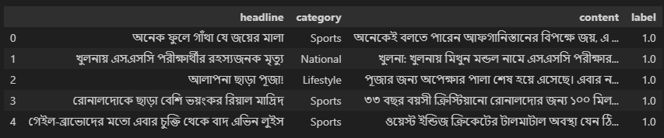
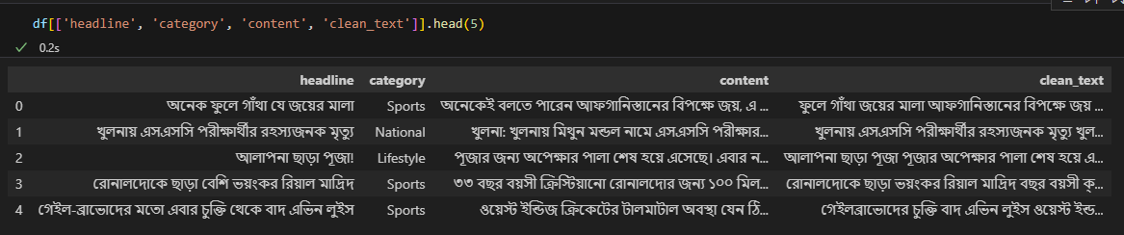
Data Cleaning
Used BNLP toolkit and RegEx(re) module for Bengali stopwords removal, punctuation, symbols, and digits text.

Slide 13
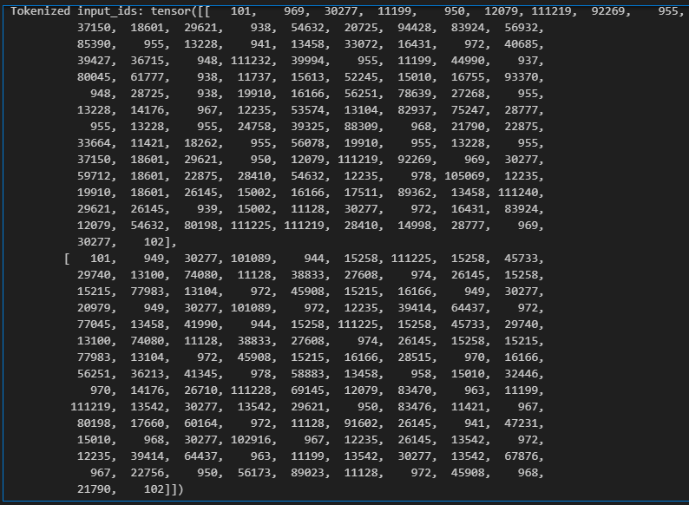
Tokenization and Embedding
Used DistilBERT tokenizer and model loaded from Hugging Face.
Max sequence length set to 128 for lower loading times.

Slide 14
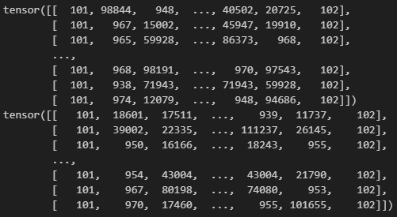
DataLoader
Tensors are formed into layers for train/validation split.

Slide 15
Model Training
BiLSTM Classifier with LayerNorm, Attention, Dropout.
Trained with Adam optimizer and BCELoss.
Hyperparameter tuning via Grid Search.
Component | Value / Shape
LSTM hidden size | 64
LSTM num layers | 2
LayerNorm before LSTM | 768
LayerNorm after LSTM | 128
Attention input dim | 128
Residual connection size | 768

Slide 16
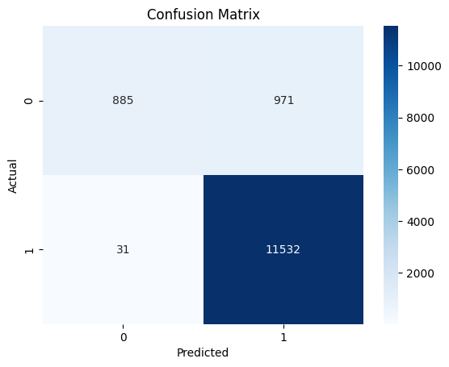
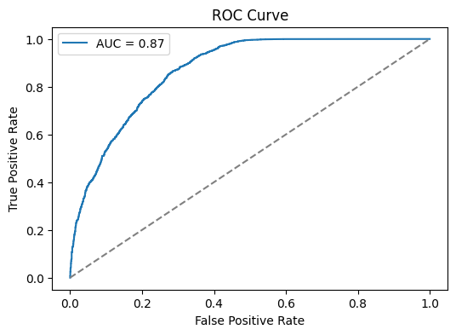
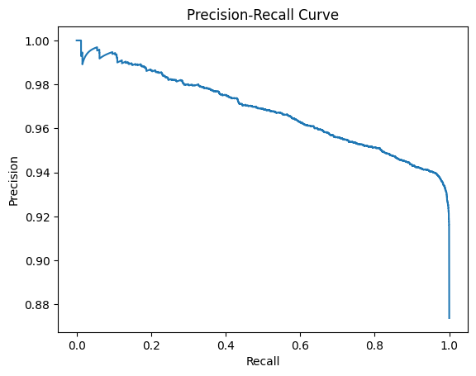
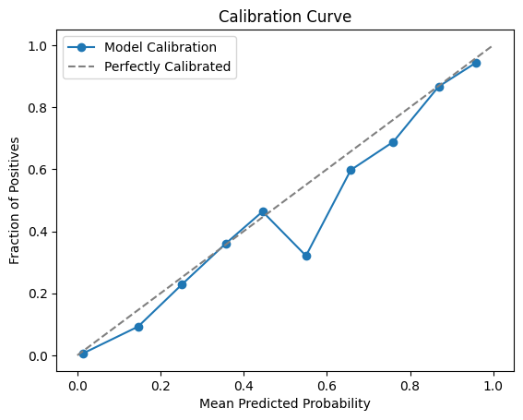
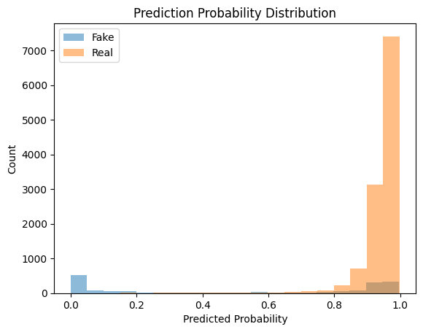
Evaluation
Confusion Matrix, Receiver Operating Characteristic(ROC), Precision-Recall, Calibration curve, Precision Probability Distribution

Slide 17
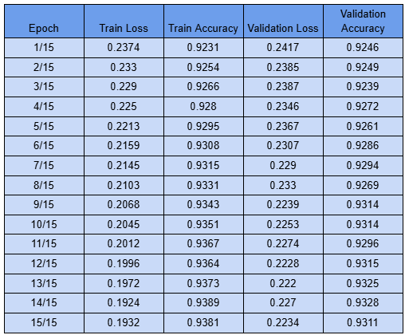
Result and Discussion

Slide 18
Result and Discussion
FINAL EVALUATION RESULTS
Metric | Value
Precision | 92.70 %
Recall | 99.47 %
F-1 Score | 95.97 %
Validation accuracy | 93.28 %
The BiLSTM + DistilBERT model effectively captures contextual and sequential information in Bengali news. High accuracy and F1 score demonstrate strong fake news detection capability. Attention and pooling mechanisms help the model focus on important parts of the news text. Calibration and probability distribution plots show reliable confidence in predictions.

Slide 19

Demonstration
custom_headline = "জলপাই তেলে মাথা মালিশ করলে বন্ধ্যাত্ব নিরাময় হয় — দাবি ফেসবুক পোস্টে"
custom_content = "সাম্প্রতিক এক ফেসবুক পোস্টে বলা হয়েছে, জলপাই তেল দিয়ে নিয়মিত মাথায় মালিশ করলে নাকি বন্ধ্যাত্বের সমস্যা দূর হয়। তবে এই দাবি কোনো বৈজ্ঞানিক গবেষণায় প্রমাণিত নয়। চিকিৎসকেরা বলছেন, এই ধরনের ভ্রান্ত তথ্য স্বাস্থ্যঝুঁকি বাড়াতে পারে।"

Slide 20
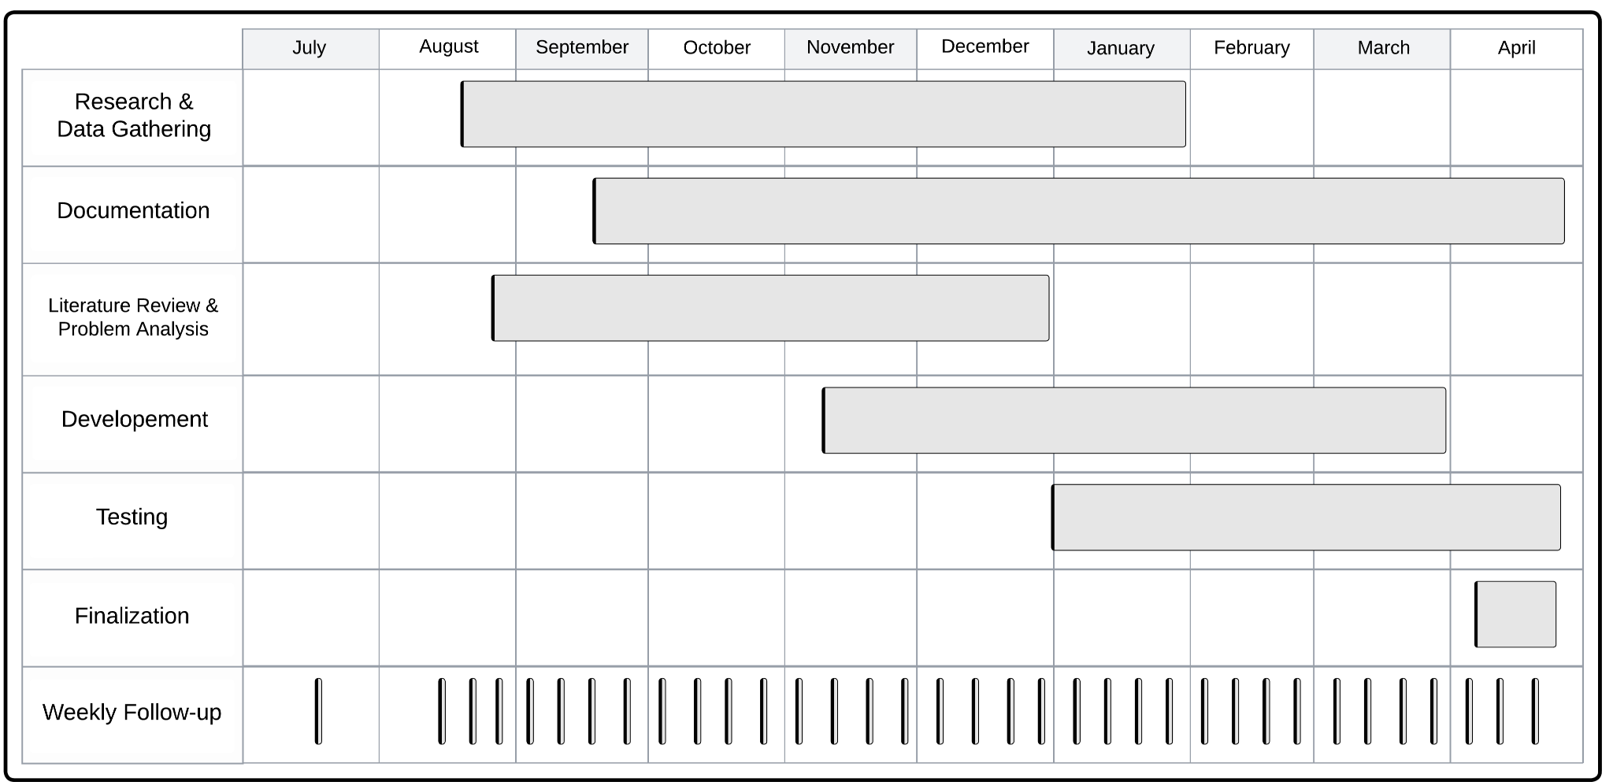
Timeline

Slide 21
Addressing Complex Engineering Problem
CO-PO Mapping of Final-Year Project
CO | Description | Related PO(s) | Assessment Methods
CO1 | Tackled a real-world problem: Bengali fake news detection using AI-based model | PO (l) Lifelong learning | Report
CO2 | Defined system requirements and adhered to ML/NLP standards | PO (b) Problem analysis,PO (c) Design/development | Report
CO3 | Planned timeline, selected tools, and managed computing resources | PO (k) Project management and finance | Report
CO4 | Designed, implemented, evaluated the hybrid model (DistilBERT + BiLSTM + Grid Search) | PO (c) Design/development,PO (d) Investigation | Report, Project Demo
CO5 | Evaluated environmental impact (energy, GPU usage, model size, efficiency) | PO (g) Environment and sustainability | Report
CO6 | Addressed social and ethical risks in labeling news content | PO (f) Engineer and society,PO (h) Ethics | Report
CO7 | Worked collaboratively within a multidisciplinary team | PO (i) Individual work and teamwork | Peer Evaluation
CO8 | Applied modern tools: Transformers, PyTorch, Colab, Grid Search | PO (e) Modern tool usage | Project Demo, Presentation
CO9 | Communicated results through report, visualizations, and oral defense | PO (j) Communication | Report, Presentation

Slide 22
Reference
Tohabar, M. Y., Nasrah, N., & Samir, A. M. (2021). Bengali fake news detection using machine learning and effectiveness of sentiment as a feature. In 2021 joint 10th international conference on informatics, electronics & vision (iciev) and 2021 5th international conference on imaging, vision & pattern recognition (icivpr) (pp. 1–8).
George, M. Z. H., Hossain, N., Bhuiyan, M. R., Masum, A. K. M., & Abujar, S. (2021). Bangla fake news detection based on multichannel combined cnn-lstm. In 2021 12th international conference on computing communication and networking technologies (icccnt) (pp. 1–5).
Mugdha, S. B. S., Kuddus, M. B. M. M., Salsabil, L., Anika, A., Marma, P. P., Hossain, Z., & Shatabda, S. (2021). A gaussian naive bayesian classifier for fake news detection in bengali. In Emerging technologies in data mining and information security: Proceedings of iemis 2020, volume 2 (pp. 283–291).
Adib, Q. A. R., Mehedi, M. H. K., Sakib, M. S., Patwary, K. K., Hossain, M. S., & Rasel, A. A. (2021). A deep hybrid learning approach to detect bangla fake news. In 2021 5th international symposium on multidisciplinary studies and innovative technologies (ismsit) (pp. 442–447).
Islam, T., Hosen, M. A., Mony, A., Hasan, M. T., Jahan, I., & Kundu, A. (2022). A proposed bi-lstm method to fake news detection. In 2022 international conference for advancement in technology (iconat) (pp. 1–5).
Syed, L., Alsaeedi, A., Alhuri, L., & Aljohani, H. (2023). Hybrid weakly supervised learning with deep learning technique for detection of fake news from cyber propaganda. array 19: 100309.
Shivani, N., Nousheen, S., Bhavani, P., & Shravani, P. (2023). Fake news detection using logistic regression. Int. J. Adv. Eng. Manag. IJAEM, 5, 1151–1154.
Bandan, S. S., Hossain, M. S., Sabbir, M. S. I., & Kobra, K. T. (2024). Deep learning for bengali fake news detection: Innovative approaches for accurate classification. International Journal of Research and Innovation in Applied Science, 9(8), 393–403.
Thair Ali, N., Falih Hassan, K., Najim Abdullah, M., & Salam Al-Hchimy, Z. (2024). The application of random forest to the classification of fake news. In Bio web of conferences (Vol. 97, p. 00049).
Mahmud, T., Ptaszynski, M., & Masui, F. (2024). Exhaustive study into machine learning and deep learning methods for multilingual cyberbullying detection in bangla and chittagonian texts. Electronics, 13(9), 1677.
Das, N. R., Alam, M. M., Polok, A. P., Raquib, M., Al Mamun, A., & Hossen, M. J. (2024). Social media bangla fake news detection using deep and machine learning algorithms. International Journal Of Engineering Trends And Technology, 72(5), 346–354.
Barua, R., Rahman, M., & Joy, U. G. (2025). Comparative analysis of bangla news classification: a study of fake news detection and multiclass classification using bert and fasttext. International Journal of Computers and Applications, 1–11.

